Slide 1
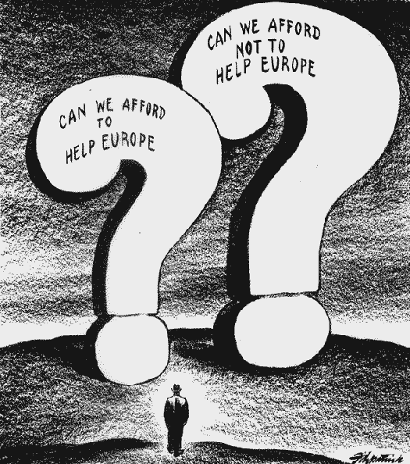
Isolationism
Definition: A policy of avoiding political or military involvement with other countries
Who: The United States supported isolationism
Why: They believed that involvement in WWI had cost the nation too much

Slide 2
Appeasement
Definition: Allowing an aggressor to do what they want in order to avoid war
Who: Great Britain and France
Why: Great Britain and France had been severely damaged by WWI. They wanted to avoid another war in Europe.

Slide 3
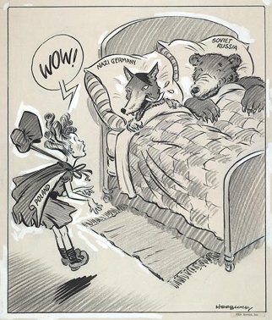
Aggression
Definition: Attacking or confronting another nation
Who: Japan, Germany, and Italy
Why: Germany and Italy were both left with out territory in the Treaty of Versailles. Japan needed to acquire raw goods to fuel their industry.

Slide 4
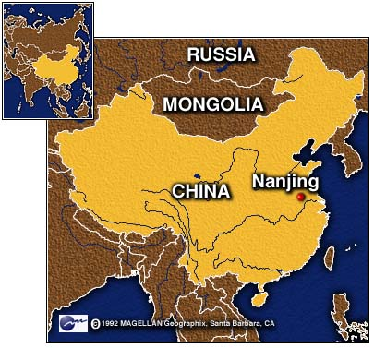
Japanese Aggression
Japan invades China
Where: Nanjing
Result: Hundreds of thousands of civilians and unarmed soldiers are massacred; an estimated 20,000-80,000 women were raped

Slide 5
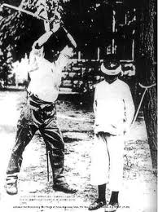
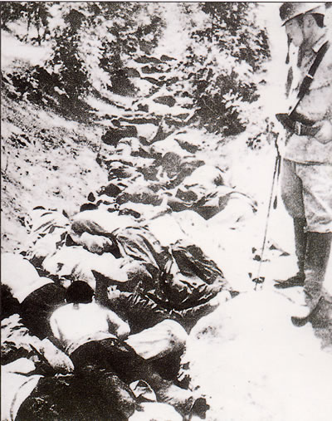
Nanjing Massacre

Slide 6
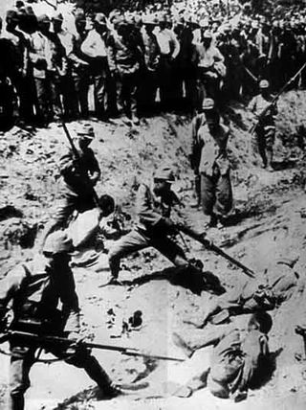
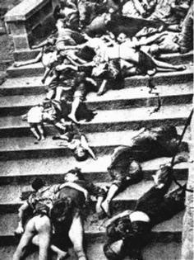
Nanjing Massacre

Slide 7
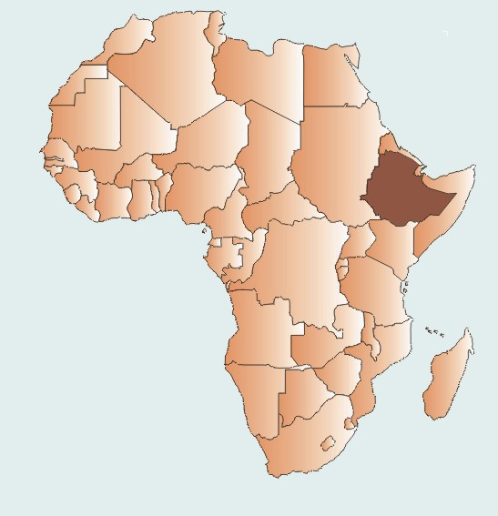
Italian Aggression
Italy invades east Africa
Where: Ethiopia
Results: Italy created an east African colony; 275,000 Ethiopians killed (including civilians and Red Cross workers); forced labor camps; mutilated bodies of killed enemies; threw captives out of airplanes mid-flight

Slide 8
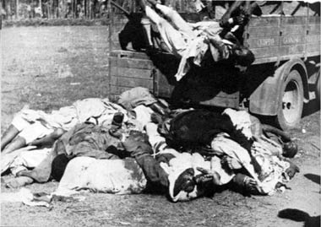
Italian Aggression

Slide 9
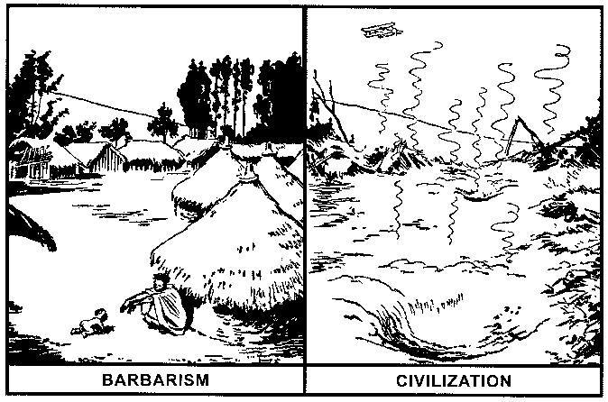
Italian Aggression

Slide 10
Spanish Civil War
General Francisco Franco installs a fascist state
Supported by Germany and Italy (troops, weapons, airplanes)
Where: Spain
Results: Estimated 50,000-200,000 people executed (including women and church officials); thousands of people raped and murdered; violent persecution of religion; Fascist state lasted until Franco’s death in 1975

Slide 11
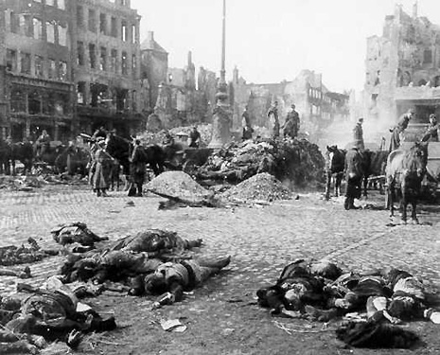
Spanish Civil War

Slide 12
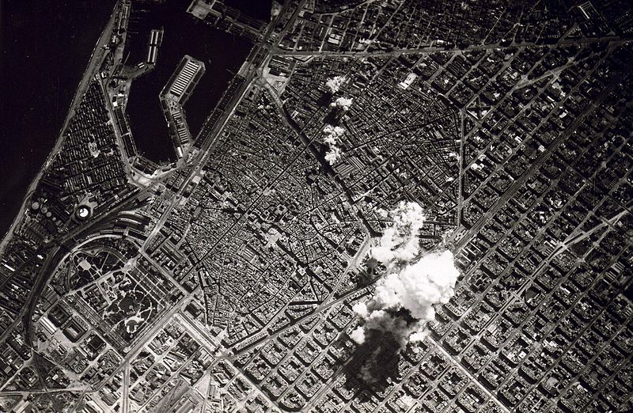
Spanish Civil War

Slide 13
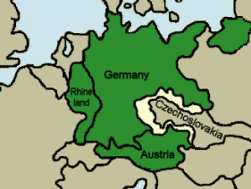
German Aggression
Where: Germany invades Austria, the Rhineland, and the Sudetenland
Result: Hitler gained power and prestige; Germany allied with Japan and Italy to form the Axis-powers

Slide 14
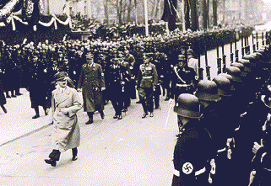
German Aggression

Slide 15
Year:1936 Author: David Low

Slide 16
Year: 1941 Author: Dr. Seuss

