Slide 1
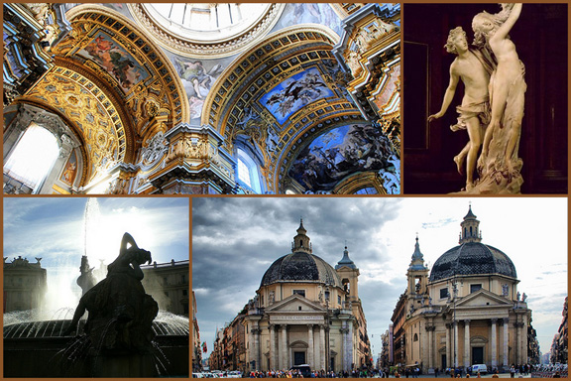
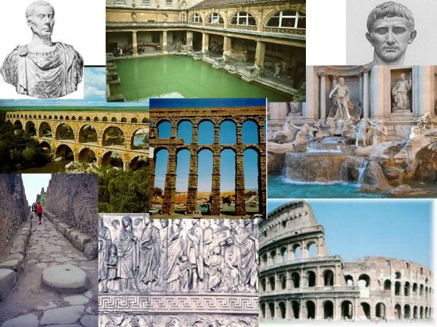
Roman Achievements/Improvements
Choose 2 Achievements/Improvements.
Explain the importance of the Achievement/Improvement and how it has effected the world. (Minimum 25 sentences for each.)
OR
Draw a picture that represents the achievement / improvement in society. (colored, 1/2 page, short description- 8 complete sentences)
Ex: Aqueducts, Colosseum, Roman Roads, Roman Arches, Advancements in the arts, Pantheon, Roman Law

