Slide 1
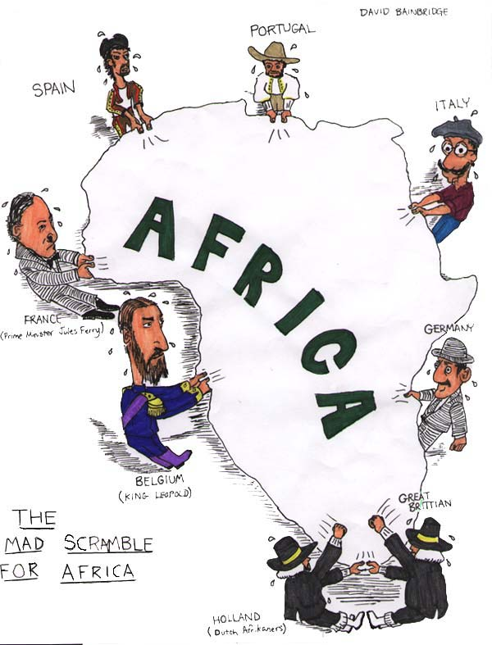
Imperialism
Policy of extending a country’s power through diplomacy or military force
Seizure of a country or territory by a stronger country
Imperialism caused by Industrial Revolution. Needs for raw materials and markets to sell goods.

Slide 2
Imperialism

Slide 3
Forms of Imperial Control
Colony – a country or territory governed by a foreign power
Protectorate – a country or territory under the control of an outside power
Sphere of Influence – an area in which an outside power claims exclusive investment or trading rights
Economic Imperialism – independent, less developed country controlled by private business interests rather than other governments

Slide 4
Imperial Management Indirect Control
Relies on existing political rulers
Local rulers are trained in foreign methods of government
Local rulers hold government offices
Goal: To develop future leaders
Foreign Rulers
Local Rulers
Colonial Population

Slide 5
Imperial Management Direct Control
Foreign officials hold government offices
No self-rule
Paternalism: providing for the needs of the colony without giving them rights
Goal: Assimilation; adopt European culture
Foreign Rulers
Colonial Population

Slide 6
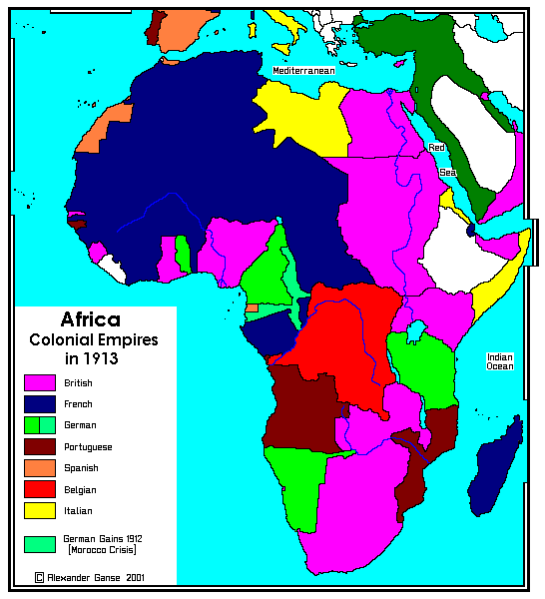
Imperialism in Africa
Pre colonization-Hundreds of ethnic groups and languages.
Berlin Conference of 1884-1885, European nations established rules for the division of Africa; African leaders not invited.
Causes:
Industrialization
Nationalism
Resources- rubber, tin, copper, gold, silver
* Liberia & Ethiopia not claimed

Slide 7
India Great Britain

Slide 8
Imperialism Political Cartoon
Working individually, develop a political cartoon depicting imperialism in Africa, India, or Southeast Asia
Your cartoon can address any of the following topics: division of land among European nations, type of economic system set up, economic products, or the impact of imperialism
Items to include: pictures/symbols, key words/phrases/ideas, caption/title
Final product should be colored on a sheet of copy paper and should fully represent the ideas discussed in class
On the back, write a 7 sentence explanation of your cartoon and how it relates to the topic

Slide 9
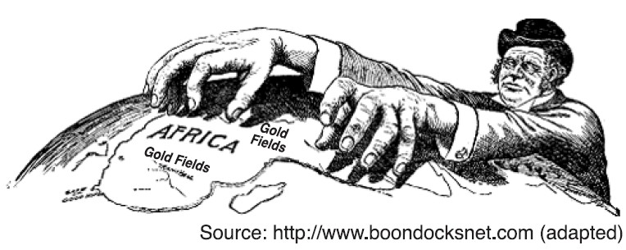
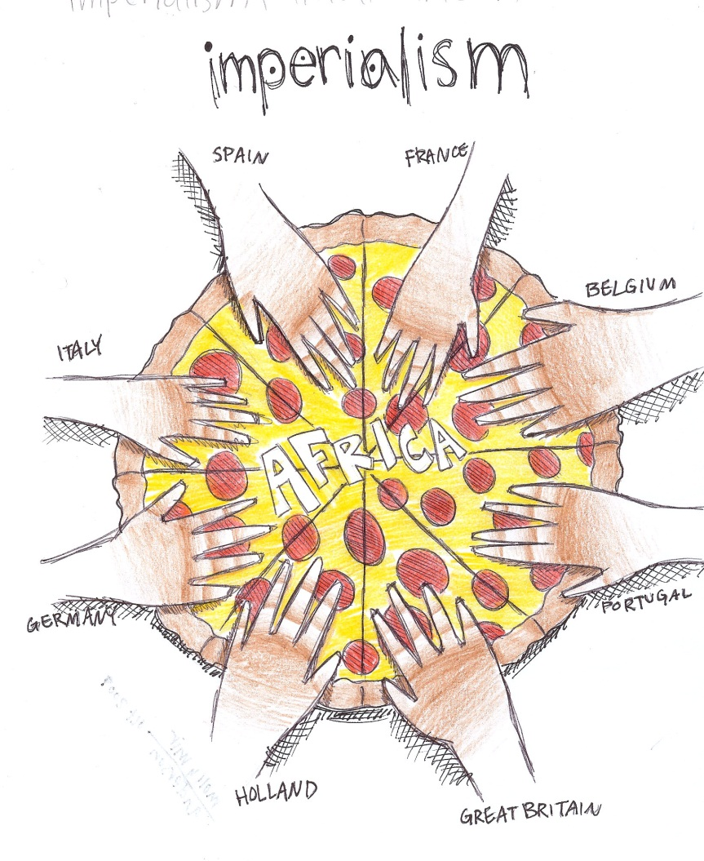
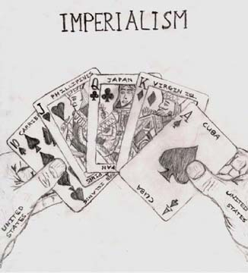

Slide 10
