Slide 1
Civilization & Mesopotamia

Slide 2
Early Civilizations

Slide 3
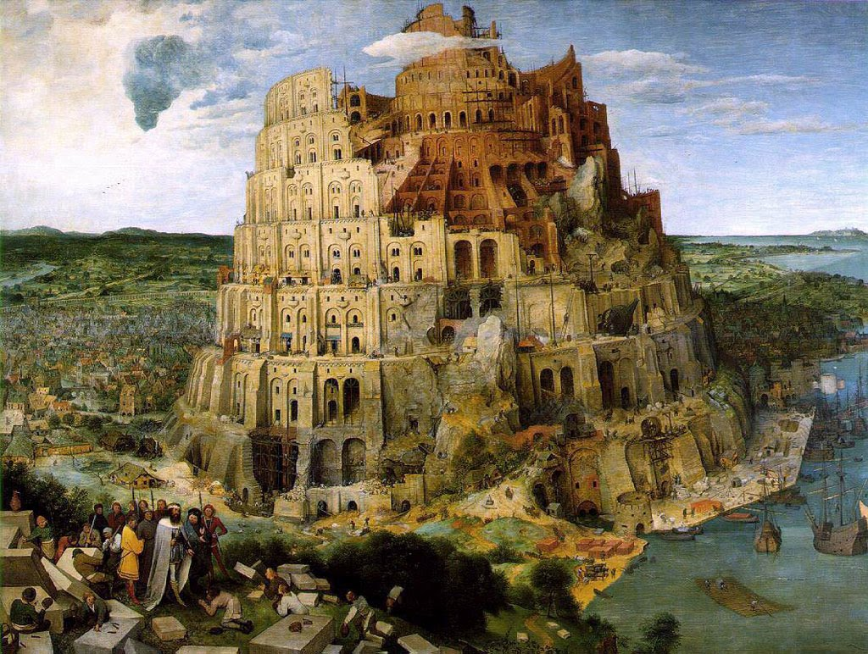
What is a civilization?
The most advanced stage of human social development and organization

Slide 4
5 Characteristics of Civilizations
Advanced Cities
Specialized Workers
Complex Institutions
Record Keeping
Advanced Technology

Slide 5
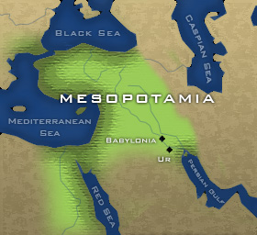
Example of Civilization: Sumer
Sumer
Specialized Workers:
soldiers, merchants, teachers, priests, etc.
Complex Institutions:
formal governments (laws and officials), priests w/ religious power
Advanced cities:
Uruk – 50,000
Lagash – 10,000 -50,000
Record Keeping: Cuneiform writing system
Advanced Technology:
3000 BCE wheel, plow, sailboat; bronze weapons and armor

Slide 6
Civilizations of Mesopotamia Fertile Crescent, “land between the rivers”

Slide 7
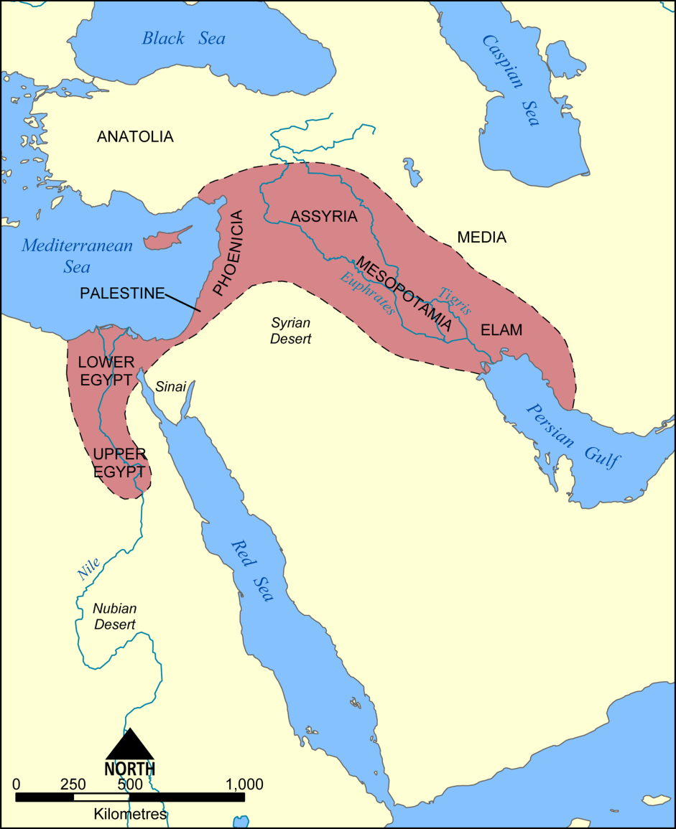
Mesopotamia
Tigris & Euphrates Rivers
City States
Dynasties
Early Empire-Babylonians

Slide 8
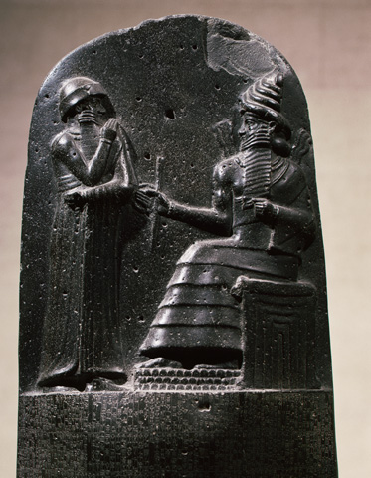
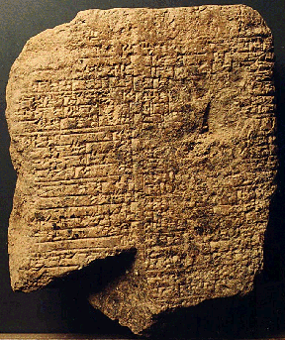
Laws
Hammurabi’s Code
Hammurabi
(Babylonian King)
Unified code of laws
Oldest known legal system
Eye for an Eye

Slide 9
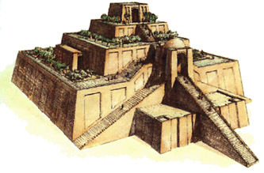
Religion
Polytheism: many gods
Ziggurats

Slide 10
Society/Culture
Kings, Priests, Landholders
Merchants
Farmers
Slaves
Sumerian
Social Hierarchy

Slide 11
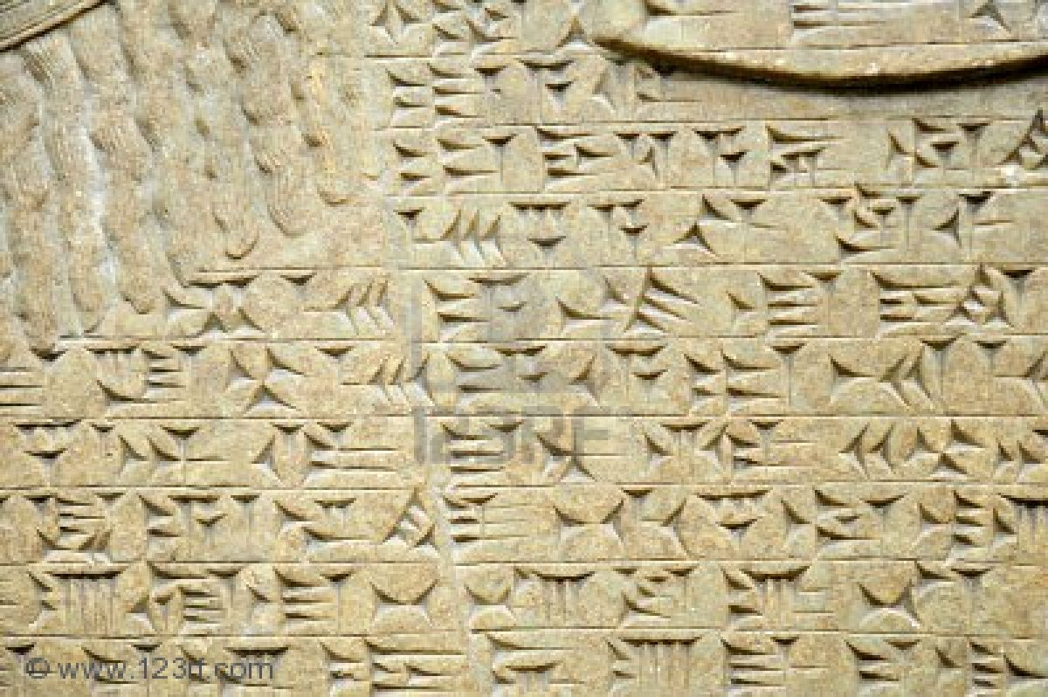
Society/Culture
Cuneiform
Writing system
Pictograph – symbols stand for words

Slide 12
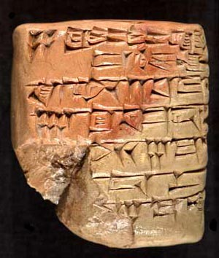
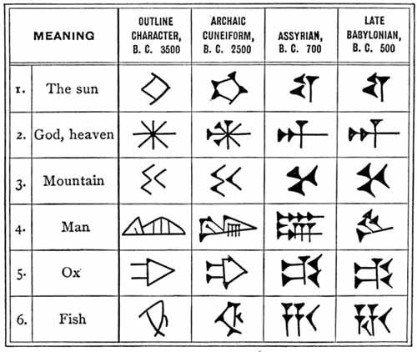
Cuneiform

Slide 13
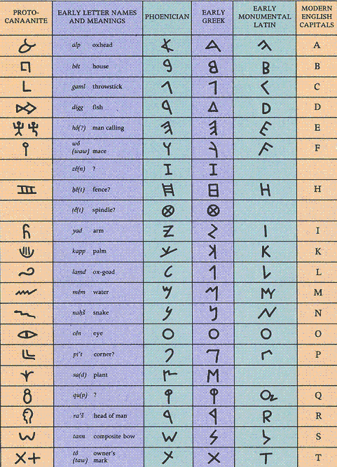
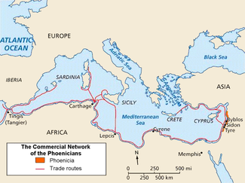
Phoenicians
Shipbuilders, Trade
Phoenician Alphabet

Slide 14
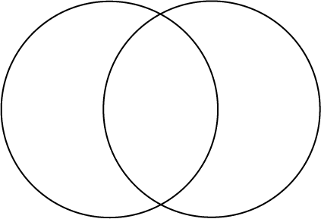
Venn Diagram-characteristics of
Ancient Civ. (15) Similarities(5) Modern Civ.(15)

