Slide 1
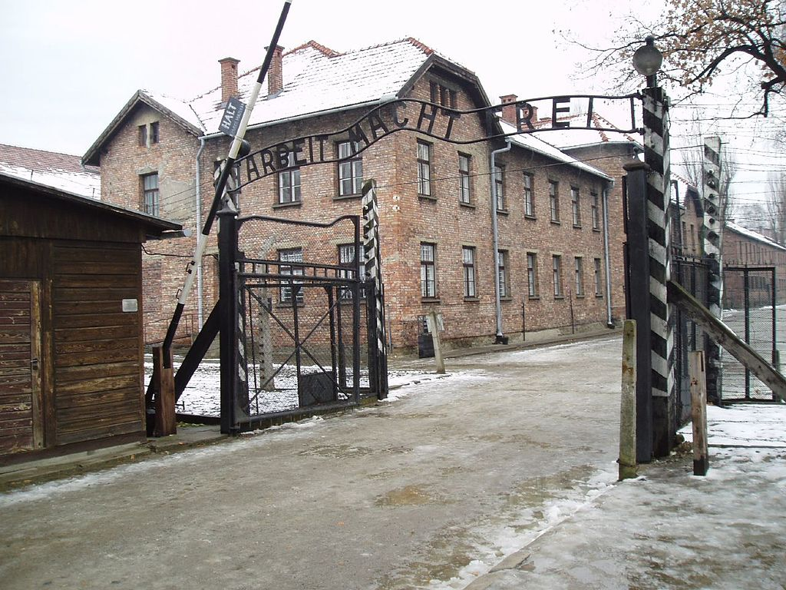

Slide 2
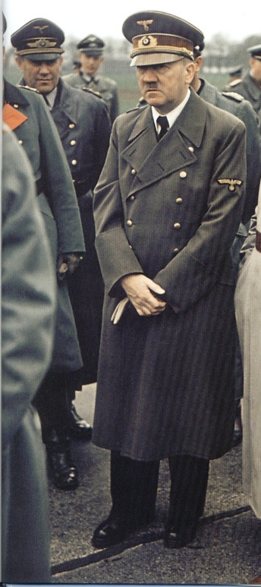
Hitler gains support in the Nazi Party by attacking the hated Treaty of Versailles
Blames Germany’s problems on Jews and foreign powers
Appointed Chancellor of Germany in 1933
Transforms the Weimar Republic into the Third Reich, a total dictatorship

Slide 3
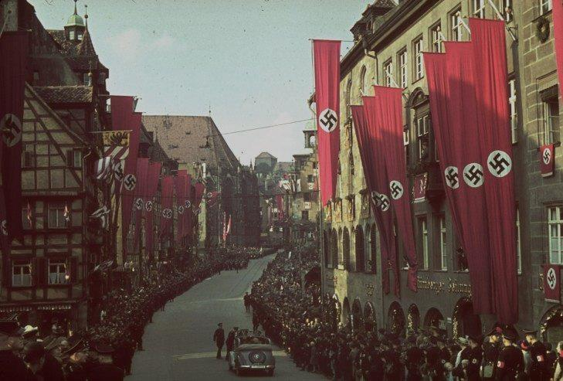
Hitler wanted to create a “master race” where Aryan people would be considered a pure race and superior to other people
Anti-Semitism or prejudice against Jews had been around for centuries

Slide 4
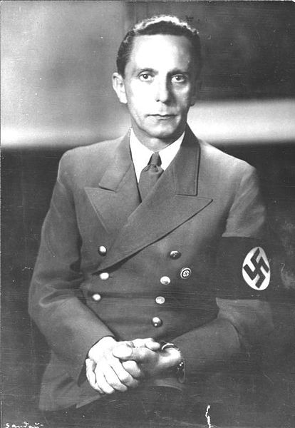
Dr. Joseph Goebbels was the head of the Nazi Propaganda Ministry and controlled all communications
Encouraged book burning to eliminate other ideas

Slide 5
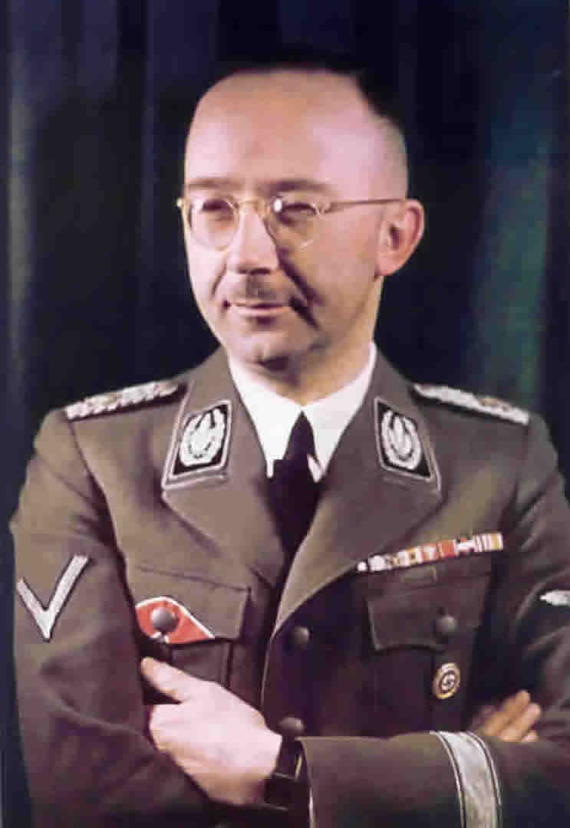
Heinrich Himmler led the SS – the Nazi’s secret police
Formed death squads known as the Einsatzgruppen
One of the architects of the Holocaust and death camps
Notes:
The Einsatzgruppen were involved in the murder of much of the intelligentsia, including members of the priesthood, and cultural elite of Poland, and had an integral role in the implementation of the so-called "Final Solution”. Almost all of the people they killed were civilians, beginning with the intelligentsia and swiftly progressing to Soviet political commissars, Jews, and Romani people as well as actual or alleged partisans throughout Eastern Europe.

Slide 6
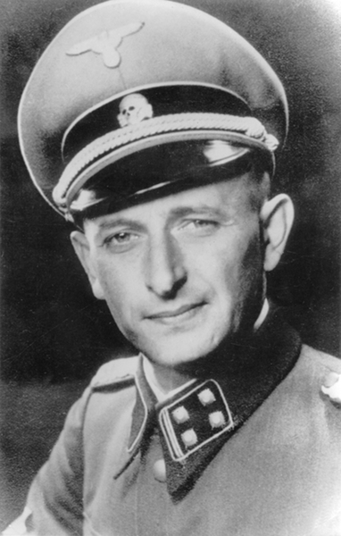
Adolf Eichmann helped to organize the Holocaust
Was in charge of transporting Jews from ghettos to concentration camps

Slide 7
Passed in 1935
Said anyone with any Jewish blood would be considered a Jew
Further restrictions were placed and persecution of the Jews increased

Slide 8
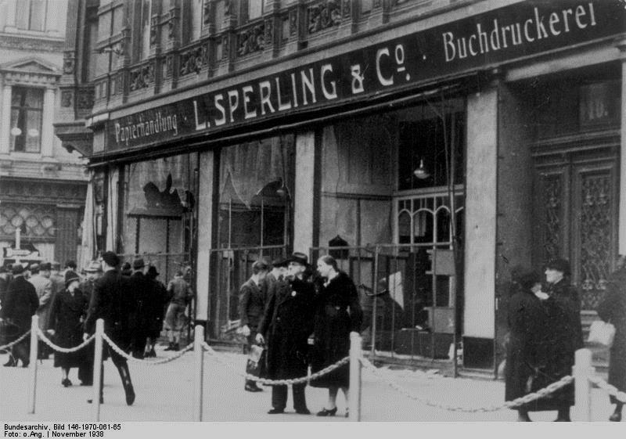
Kristallnacht -“Night of Broken Glass” took place November 1938.
Jewish stores, houses, and synagogues were systematically destroyed
Marks the beginning of widespread government-led violence against Jews

Slide 9
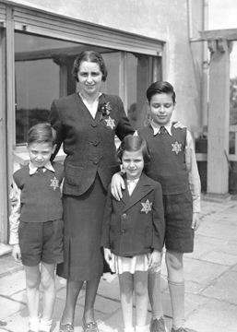
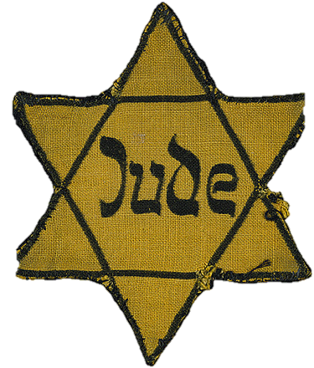
Jewish Registry created where all people with Jewish ancestry had to register with the government
Jews had to wear the Star of David badge everywhere the went
Forced to live in isolated ghettos

Slide 10
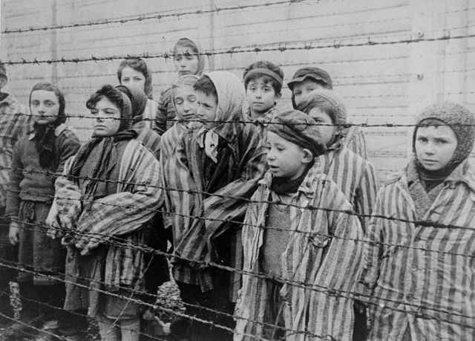
Plan developed in 1942 to eliminate all Jews from Europe
Jewish people from across Europe were taken to concentration camps
In the camps they were used for hard labor or killed
Notes:
This policy of deliberate and systematic genocide starting across German-occupied Europe was formulated by Nazi leadership in January 1942 at the Wannsee Conference held near Berlin. Obergruppenführer Reinhard Heydrich was the most prominent “architect” of it.

Slide 11
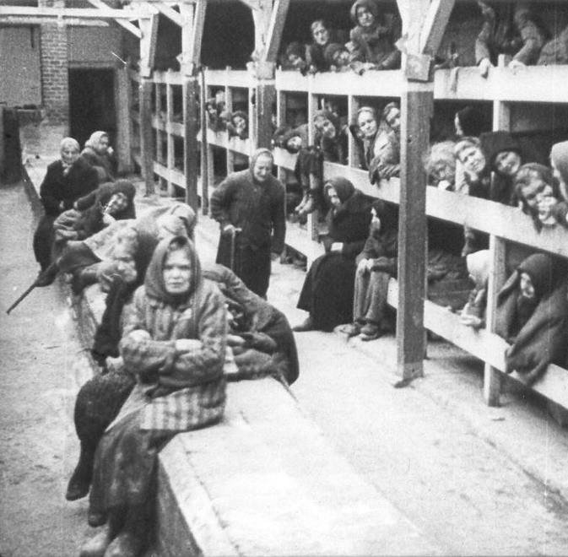
Many could better be classified as extermination camps - set up to kill a mass number of Jewish people
Dr. Josef Mengele carried out experiments on Jewish people at Auschwitz

Slide 12
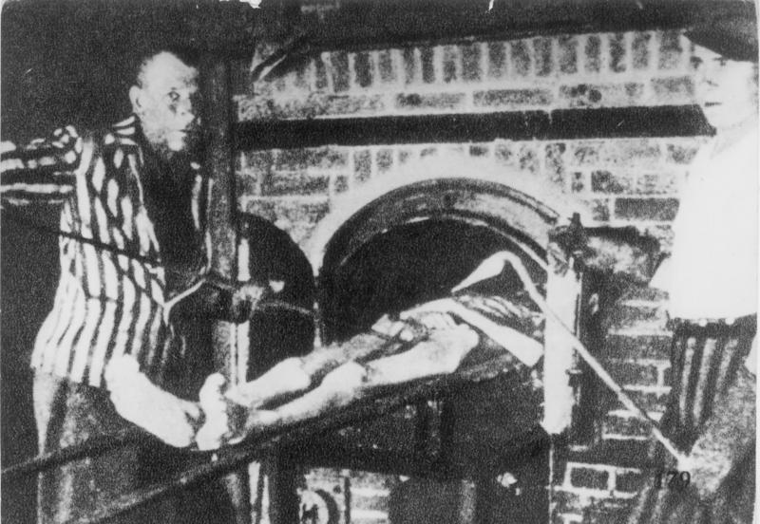
© Students of History - http://www.teacherspayteachers.com/Store/Students-Of-History
Notes:
Dachau was the first of the Nazi concentration camps opened in 1933, intended to hold political prisoners. It is located on the grounds of an abandoned munitions factory northeast of the medieval town of Dachau, about 10 mi northwest of Munich in southern Germany. Opened by Heinrich Himmler, its purpose was enlarged to include forced labor, and eventually, the imprisonment of Jews, German and Austrian criminals, and eventually foreign nationals from countries that Germany occupied or invaded. The Dachau camp system grew to include nearly 100 sub-camps. The camps were liberated by U.S. forces on 29 April 1945.

Slide 13
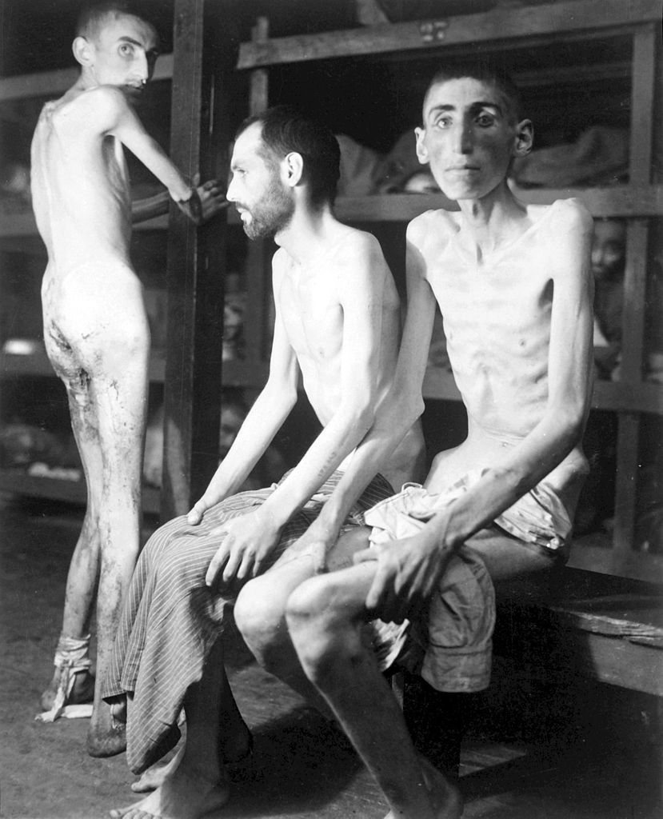
Notes:
Chełmno was the first of the Nazi German extermination camps and was situated 31 miles north of the metropolitan city of Łódź, Poland. Following the invasion of Poland in 1939 Germany annexed the area aiming at its complete "Germanization"; the camp was set up specifically to carry out ethnic cleansing through mass killings. It operated from December 8, 1941 with Operation Reinhard during the most deadly phase of the Holocaust, and again from June 23, 1944 to January 18, 1945 during the Soviet counter-offensive. Polish Jews of the Łódź Ghetto and the local inhabitants were exterminated there. In 1943 modifications were made to the camp's killing methods because the reception building was already dismantled.

Slide 14
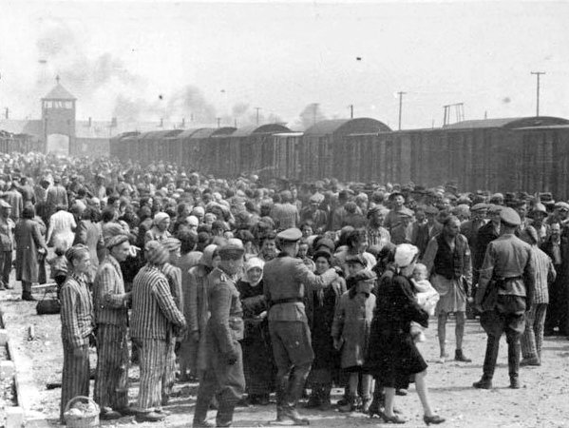
Notes:
Buchenwald was near Weimar, Germany, and opened in July 1937. It was one of the first and the largest of the concentration camps within Germany's 1937 borders. Many actual or suspected communists were among the first internees. Prisoners from all over Europe and the Soviet Union—Jews, Poles and other Slavs, the mentally ill and physically disabled, political prisoners, Romani people, Freemasons, criminals, homosexuals, and prisoners of war—worked primarily as forced labor in local armaments factories.

Slide 15
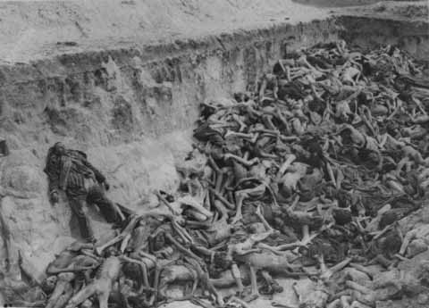
Notes:
Nazi concentration camp in what is today Lower Saxony in northern Germany, southwest of the town of Bergen near Celle. Originally established as a prisoner of war camp, in 1943, parts of it became a concentration camp. Initially this was an "exchange camp", where Jewish hostages were held with the intention of exchanging them for German prisoners of war held overseas. The camp was later expanded to accommodate Jews from other concentration camps.

Slide 16
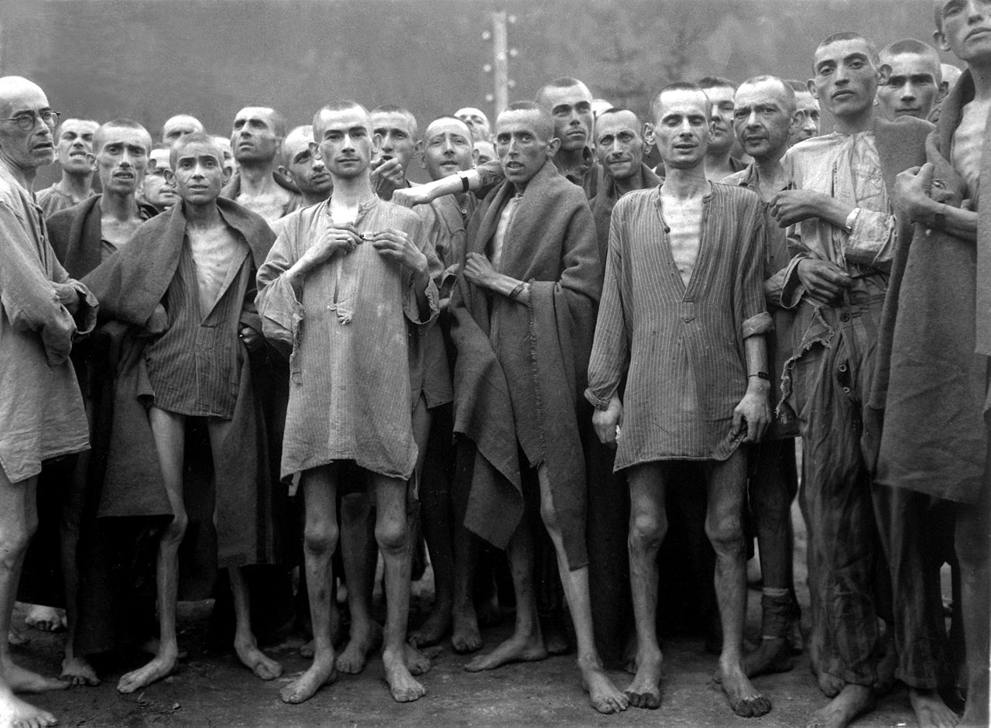

Slide 17
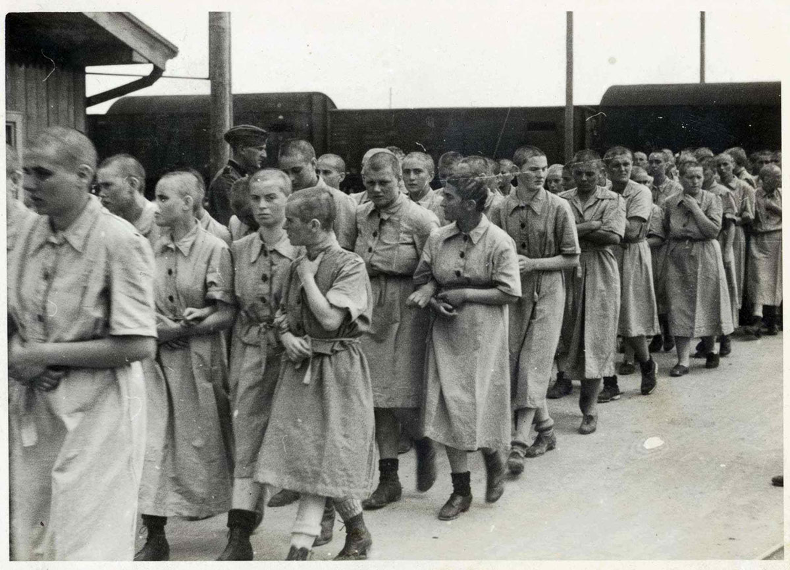
Notes:
Women in Auschwitz II, May 1944

Slide 18
Underground resistance movements were formed to assist Jews in escaping
The residents of Le Chambon-sur-Lignon - a village in the south of France helped thousands of Jews escape to freedom
Jewish children sheltered by the Protestant population of Le Chambon-sur-Lignon.
Notes:
The Nazis and the collaborationist Vichy regime were rounding up Jews in France and sending them to the death camps. Under the remarkable leadership of local Protestant minister Pastor André Trocmé, and his deputy pastor Edouard Theis, the citizens of the village of Le Chambon-sur-Lignon risked their lives to rescue and hide Jews from being rounded up. They hid the Jews in private homes, on farms in the area, as well as in public institutions. Whenever the Nazi patrols came searching, the Jews were hidden in the mountainous countryside.

Slide 19
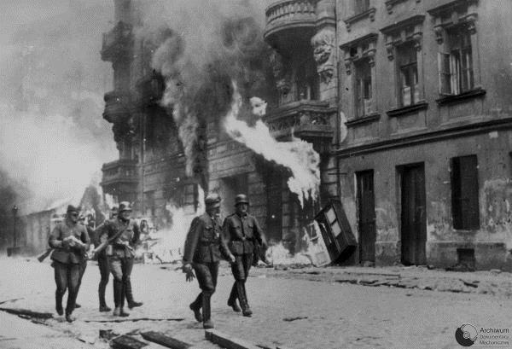
Warsaw Ghetto Uprising - April 19, 1943
750 Jews were able to hold off German soldiers to avoid being taken to the concentration camps
Eventually lost the battle – 7,000 were killed and 56,000 were deported.

Slide 20
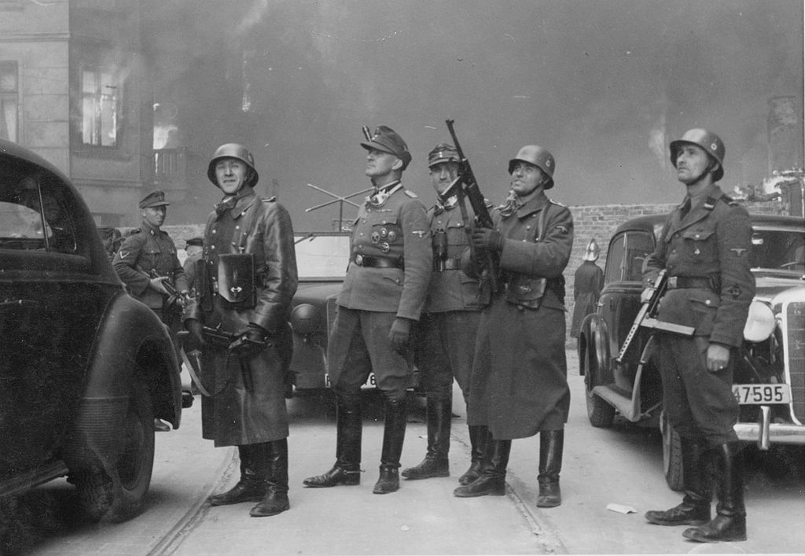
© Students of History - http://www.teacherspayteachers.com/Store/Students-Of-History
Nazi SS soldiers burning the Warsaw Ghetto after the uprising in 1943.

Slide 21
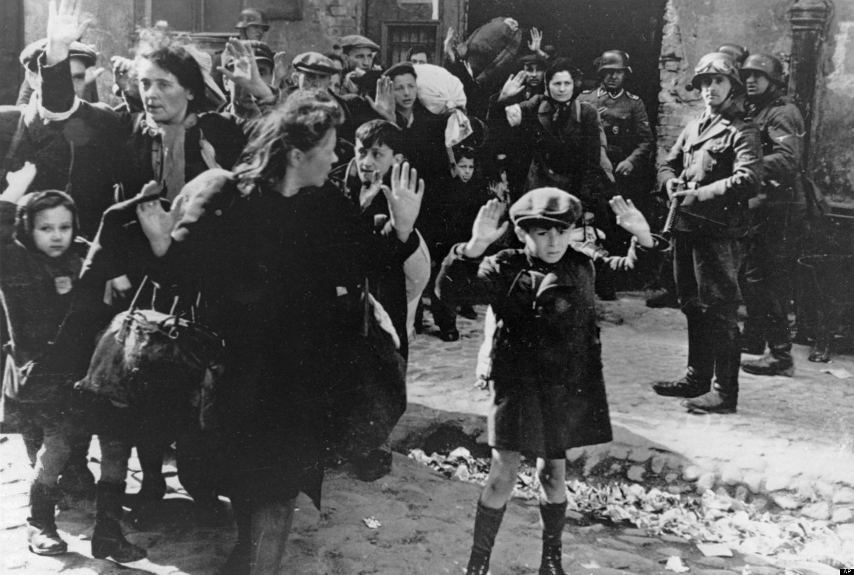
Nazi SS soldiers leading the deportation of all Jews from Warsaw after the uprising.

Slide 22
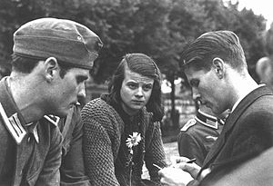
The “White Rose” resistance group distributed anti-Nazi pamphlets
Led by students Sophie and Hans Scholl
Caught by German authorities and killed in 1942
Notes:
Sophie and Hans Scholl were students at the University of Munich when they formed the White Rose, a student-led resistance movement.
“We fight with our words,” Sophie said; and in June 1942, the first anti-Nazi leaflet appeared in Munich mailboxes. It was an eloquent plea for resistance and truth, aimed at the millions of Germans who shut their eyes to the brutalities enacted by their dictator. Each member of the White Rose understood the crime—high treason—and the punishment meted out to such offenders. “We were all aware we were risking our necks,” one member said.

Slide 23
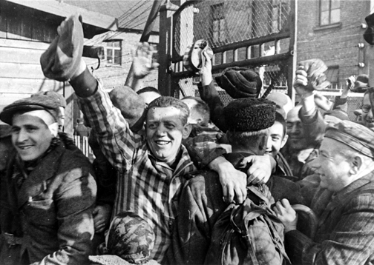
Allied forces reach camps starting in summer 1944
Soviet forces liberate Auschwitz and camps in Poland and Eastern Germany
American forces liberate Buchenwald and camps in the west

Slide 24
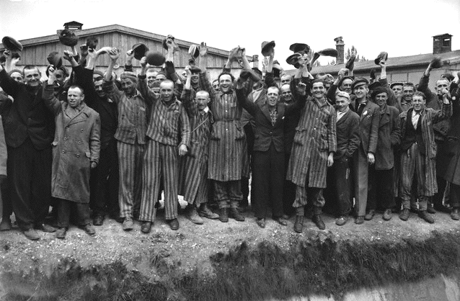
© Students of History - http://www.teacherspayteachers.com/Store/Students-Of-History

Slide 25
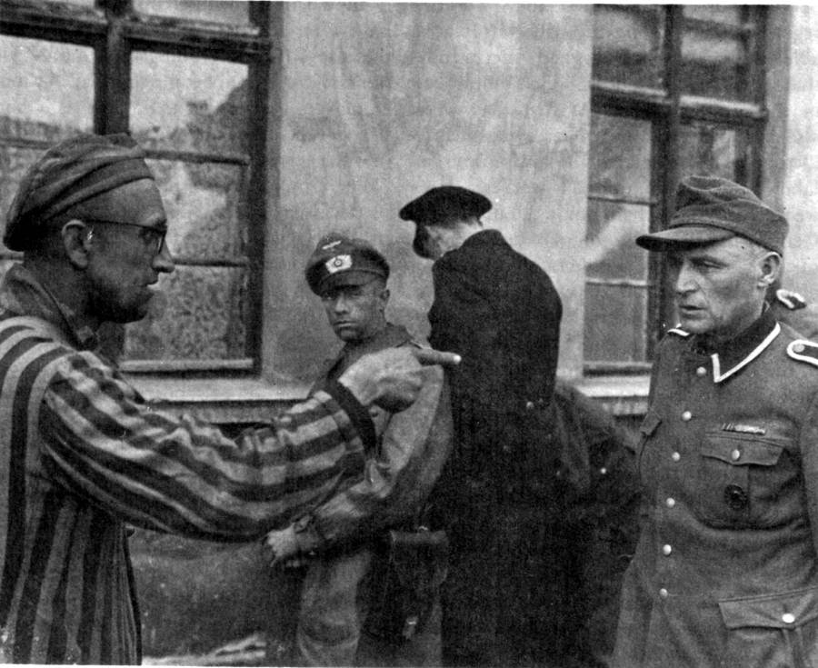
© Students of History - http://www.teacherspayteachers.com/Store/Students-Of-History

Slide 26
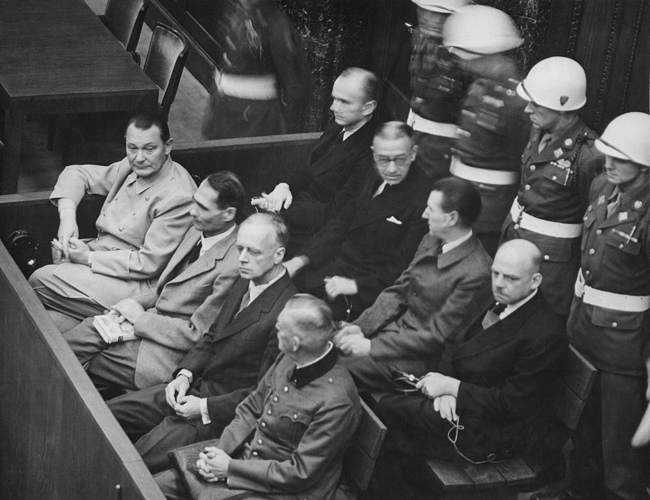
As the war ended, many top Nazis committed suicide
22 major Nazi criminals were tried for their crimes in Nuremberg
Most claimed to be “just following orders”
12 were sentenced to death
Some escaped to South America where they hid for years

Slide 27
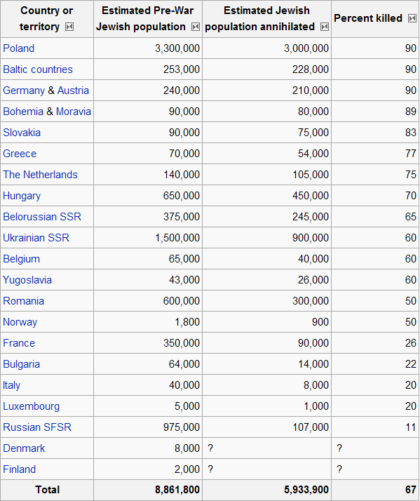

Slide 28
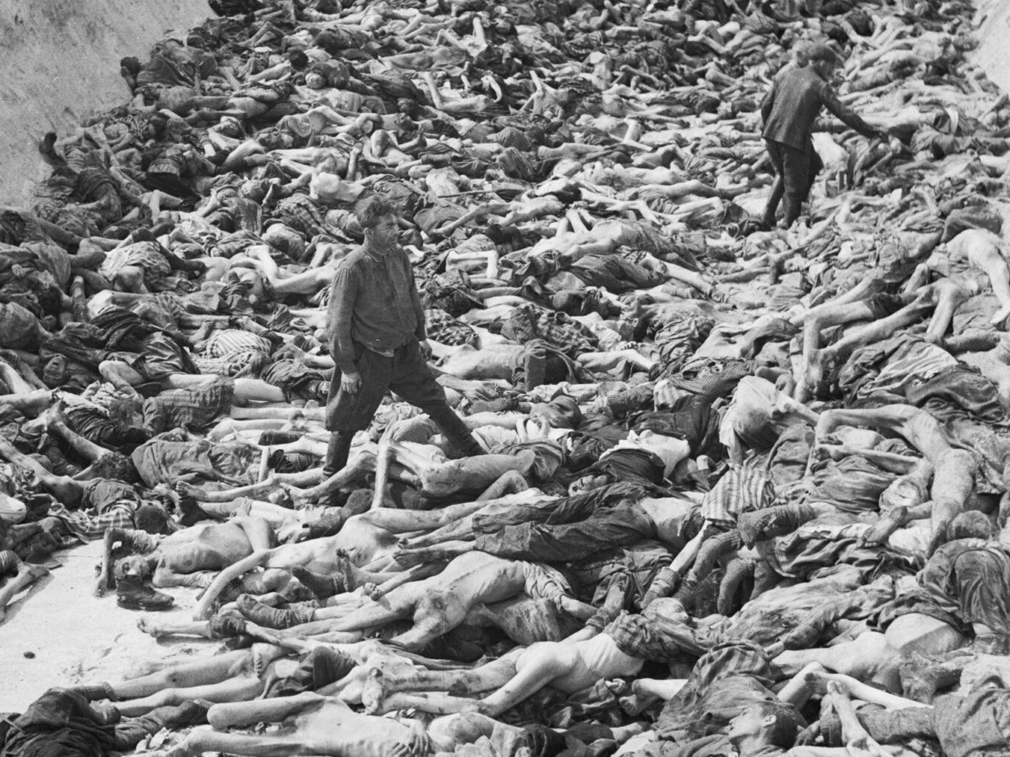
Notes:
The Liberation of Bergen-Belsen Concentration Camp, April 1945. Dr Fritz Klein, the camp doctor, standing in a mass grave at Belsen. Klein, who was born in Austro-Hungary, was an early member of the Nazi Party and joined the SS in 1943. He worked in Auschwitz-Birkenau for a year from December 1943 where he assisted in the selection of prisoners to be sent to the gas chambers. Klein was convicted of two counts of war crimes and executed in December 1945.

Slide 29
